Slide 1

JAVA DEVELOPMENT PROJECT
Vehicle Rental System
A polymorphic implementation of a vehicle rental engine featuring brand-specific rates and automated calculations.

Slide 2







CORE OBJECTIVES
OOP Pillars
Dynamic Pricing
Demonstrating inheritance through a Vehicle base class and specialized Car/Bike child classes.
Implementing distinct rate structures using Method Overriding to calculate complex rental costs.
User Interface
Data Integrity
Providing a robust console-based experience with interactive menus and formatted receipt outputs.
Using super() for constructor chaining to ensure all parent properties are initialized correctly.

Slide 3
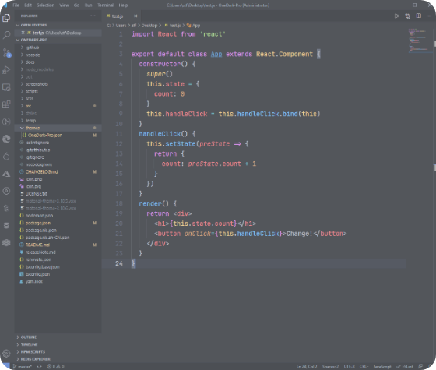
SYSTEM WORKFLOW
Operational Steps
Selection: User picks vehicle type (Car/Bike).
Configuration: System assigns a specific base rate per brand.
Processing: User enters rental duration in days.
Execution: Runtime polymorphism triggers the child's calculation logic.

Slide 4
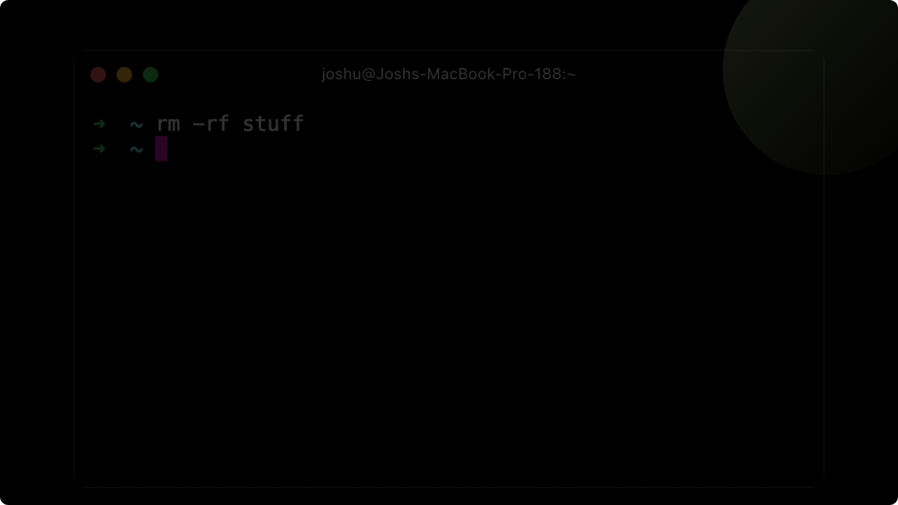
PROJECT SCREENSHOTS
LIVE EXECUTION FROM THE CONSOLE

Slide 5

INTERACTIVE SELECTION
Main.java - Console Output
================================================
VEHICLE RENTAL MANAGEMENT SYSTEM
================================================
Select Vehicle Type:
1. Car
2. Bike
Enter choice (1 or 2): 1
Select a Car Brand (Unique base rates):
1. Hyundai i20 - Economy (Base: 600/day)
2. Tata Nexon - SUV (Base: 900/day)
3. Honda Civic - Luxury (Base: 1200/day)
Enter choice (1-3): 3

Slide 6

FINAL RECEIPT GENERATION
Enter number of days to rent: 5
------------------------------------------------
FINAL RENTAL RECEIPT
------------------------------------------------
Vehicle Number :
Brand/Model : Honda Civic
Base Rate/Day : 1200.0
Rental Duration: 5 days
Total Rent Due : 7000.0
================================================

Slide 7




CALCULATION ALGORITHMS
Car Logic
Bike Logic
Includes a flat premium service fee for car maintenance and overhead.
Applies a 10% promotional discount to encourage eco-friendly travel.

Slide 8

Conclusion
The project successfully applies Core Java concepts to solve a real-world business scenario.
Questions & Feedback?
github.com/project-repo | dev-team@company.com

